Slide 1

STEM investigation of dilute N containing InAs
Shalini Gupta¹, Andreas Beyer¹, Manoj Kesaria², Anthony Krier² and Kerstin Volz¹
¹Philipps-Universität Marburg, Faculty of Physics and Materials Science Center, Marburg, Germany
²Physics Department, Lancaster University, UK

Slide 2
Motivation
0.1 µm p+ InAs X10¹⁸
0.3µm p+ InAs X10¹⁷
20 nm InAs
10nm InAlAs
10nm InAs
10nm InAlAs
20 nm InAs
0.1µm n+ InAs X10¹⁷
0.3µm n+ InAs X10¹⁸
InAs: n-type
simulation
A0 846
Reference sample A0 846
[1]
0.1 µm p+ InAs X10¹⁸
0.3µm p+ InAs X10¹⁷
20 nm InAs
10nm InAlAs
10nm InNAs
10nm InAlAs
20 nm InAs
0.1µm n+ InAs X10¹⁷
0.3µm n+ InAs X10¹⁸
InAs: n-type
simulation
A0 848
Main sample A0 848 [2]
[1] & [2] : Prof. Anthony Krier, Lancaster University

Slide 3
Motivation
0.1 µm p+ InAs X10¹⁸
0.3µm p+ InAs X10¹⁷
20 nm InAs
10nm InAlAs
10nm InAs
10nm InAlAs
20 nm InAs
0.1µm n+ InAs X10¹⁷
0.3µm n+ InAs X10¹⁸
InAs: n-type
simulation
A0 846
STEM measurements to investigate
Structural perfection of QWs
Abruptness of interfaces
Reference sample A0 846
[1]
0.1 µm p+ InAs X10¹⁸
0.3µm p+ InAs X10¹⁷
20 nm InAs
10nm InAlAs
10nm InNAs
10nm InAlAs
20 nm InAs
0.1µm n+ InAs X10¹⁷
0.3µm n+ InAs X10¹⁸
InAs: n-type
simulation
A0 848
Main sample A0 848 [2]
[1] & [2] : Prof. Anthony Krier, Lancaster University

Slide 4
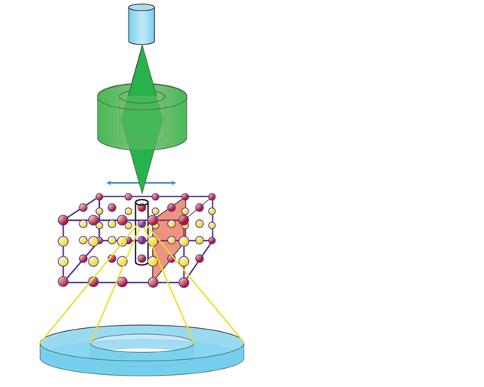
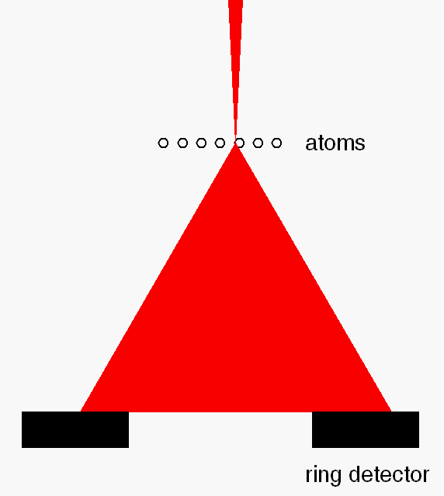
Scanning transmission electron microscopy
STEM uses a focused electron beam that is scanned over the sample’s surface
Incident electrons get scattered from the sample’s atoms (Rutherford scattering)
HAADF detector collects the signal from the scattered electrons
lens
Focussed electron beam
High angle annular dark field imaging (HAADF) ➔ Z-contrast
sample
HAADF detector
recording of HAADF intensity
[3]
[3] Knut Müller-Caspary, Universität Bremen

Slide 5
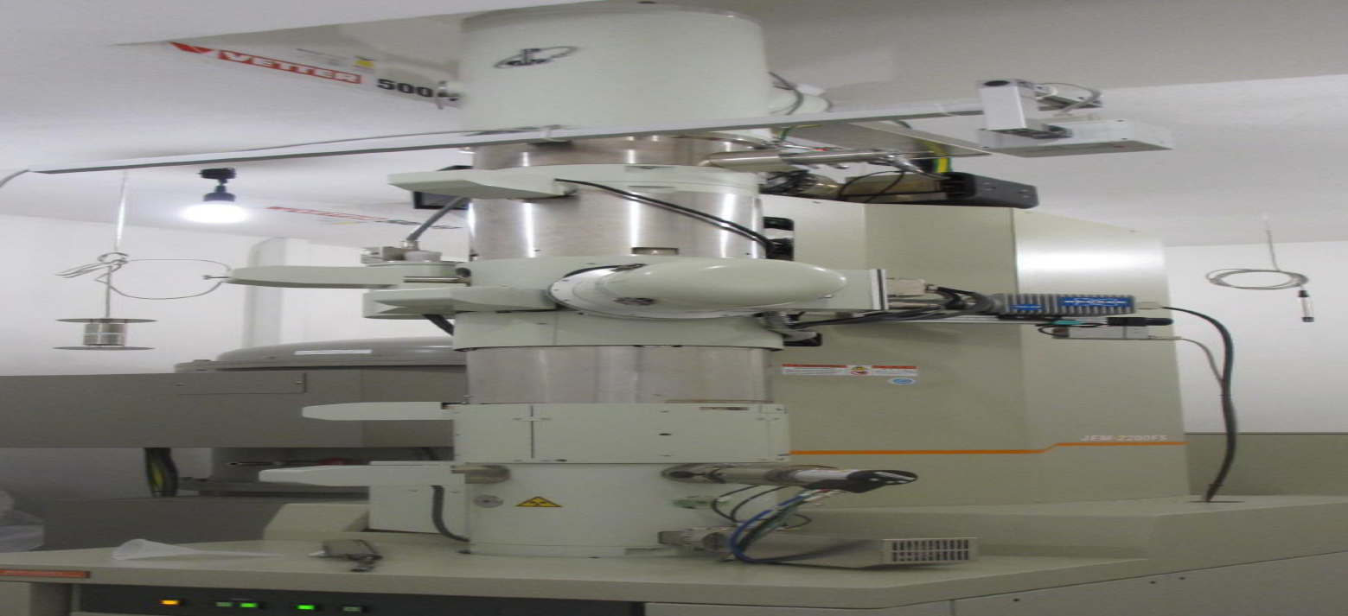
Scanning transmission electron microscopy
STEM uses a focused electron beam that is scanned over the sample’s surface
Incident electrons get scattered from the sample’s atoms (Rutherford scattering)
HAADF detector collects the signal from the scattered electrons
High angle annular dark field imaging (HAADF) ➔ Z-contrast
JEOL JEM 2200 FS
Double- C_{S}-corrected
[3]
recording of HAADF intensity
[3] Knut Müller-Caspary, Universität Bremen

Slide 6
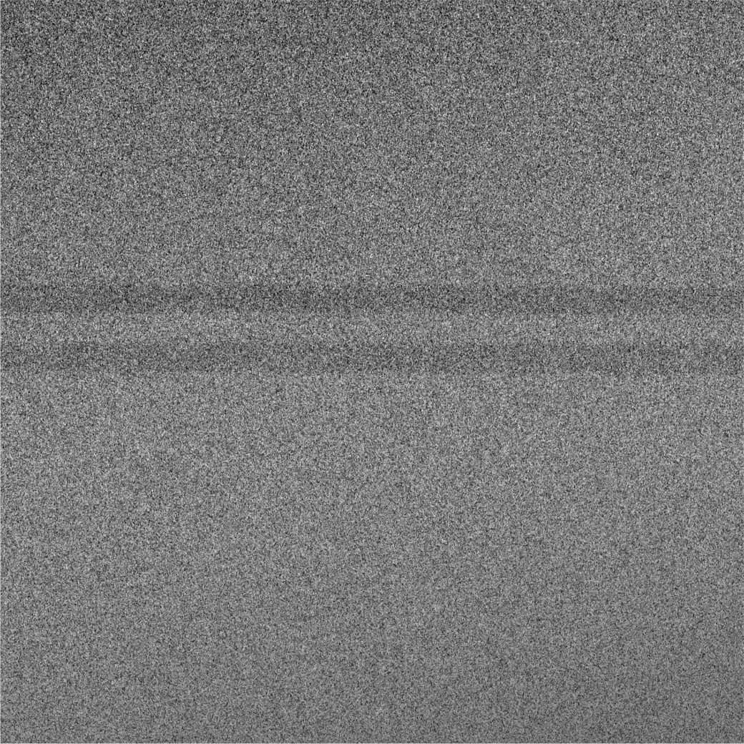
HAADF STEM image of reference sample
0.1 µm p+ InAs X10¹⁸
0.3µm p+ InAs X10¹⁷
20 nm InAs
10nm InAlAs
10nm InAs
10nm InAlAs
20 nm InAs
0.1µm n+ InAs X10¹⁷
0.3µm n+ InAs X10¹⁸
InAs: n-type
InAs
InAlAs
InAs
InAlAs
Growth direction
InAs
100 nm

Slide 7
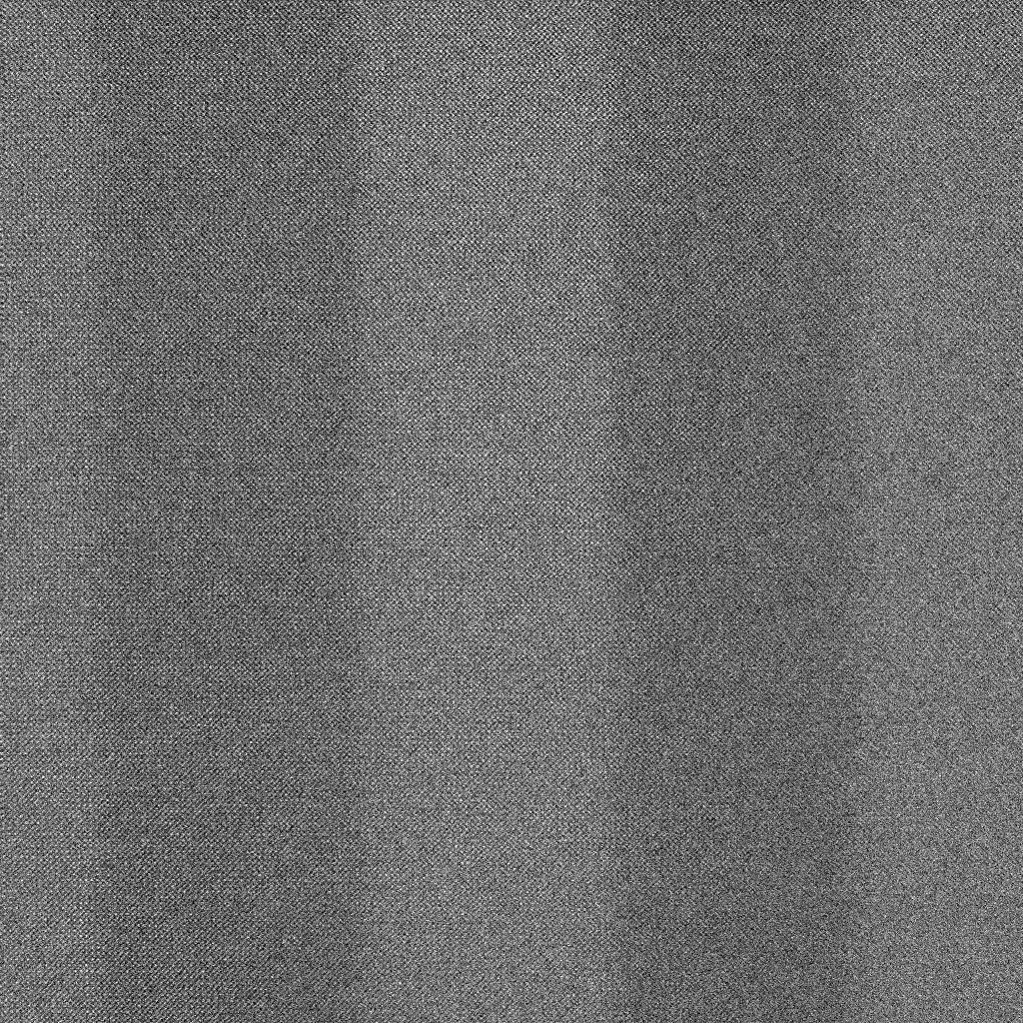
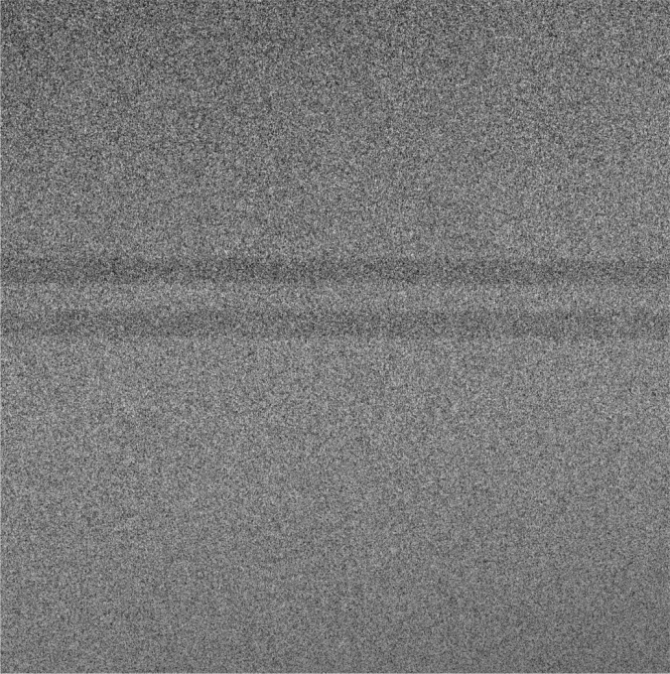
HAADF STEM image of reference sample
InAs
InAlAs
InAs
InAlAs
InAlAs
InAs
Growth direction
InAs
Growth direction
InAs
InAlAs
100 nm
20 nm
InAs

Slide 8
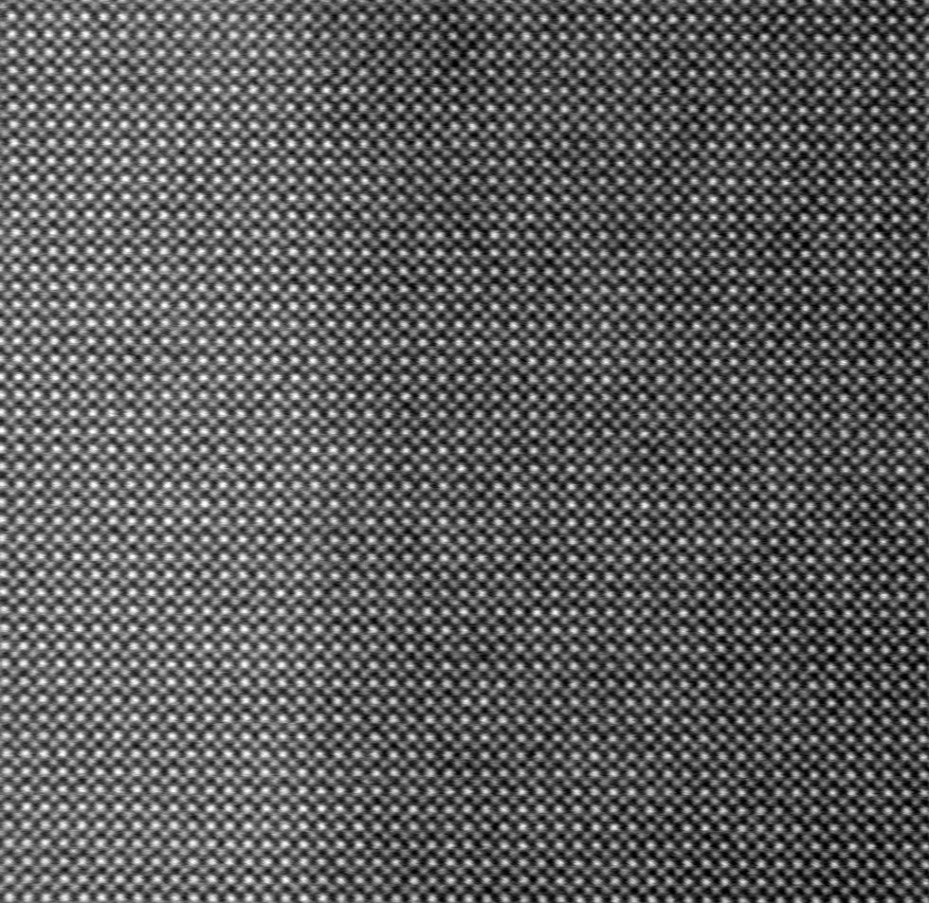
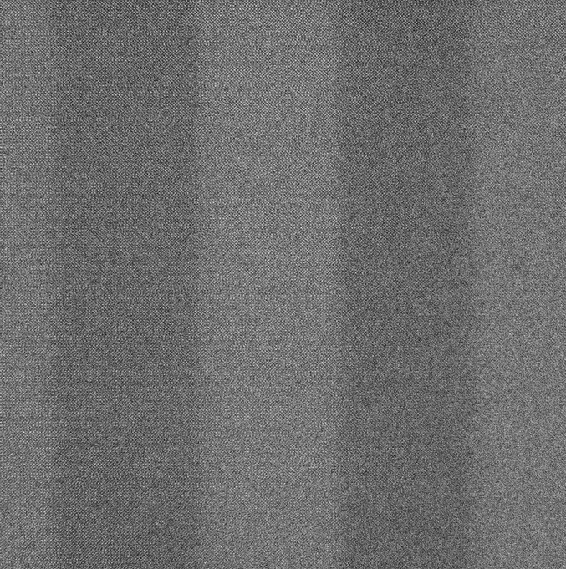
HAADF STEM image of reference sample
InAs
InAlAs
Growth direction
InAs
InAlAs
20 nm
InAs
5 nm

Slide 9

HAADF STEM image of reference sample
InAs
InAlAs
Growth direction
InAs
InAlAs
20 nm
InAs
5 nm

Slide 10
HAADF STEM image of reference sample
InAs
InAlAs
Growth direction
InAs
InAlAs
20 nm
InAs
5 nm

Slide 11
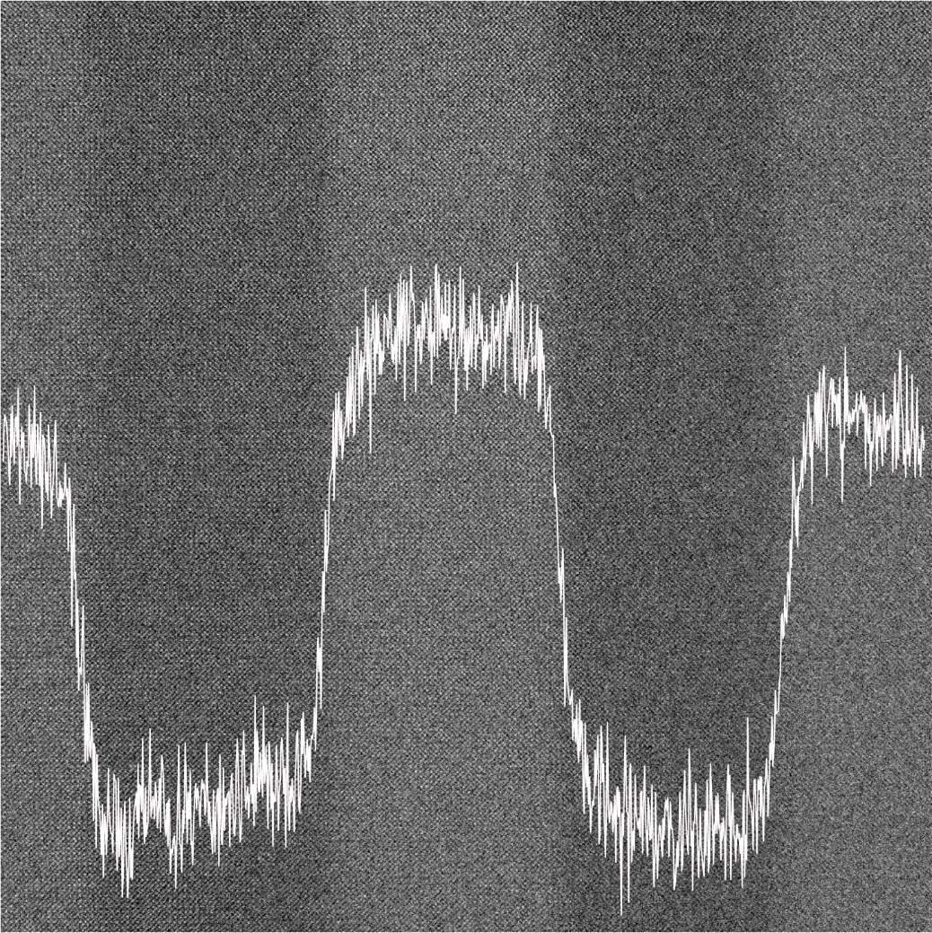
Quantitative Evaluation of images
intensity decreases
InAs
5 nm
InAlAs
5 nm
5 nm
Growth direction
InAs
5 nm
InAlAs
20 nm
InAs

Slide 12
Quantitative Evaluation of images
Detection of the individual layer
InAs
Results
Mean width = 12.4 nm
Standard deviation = 0.4 nm
Roughness = 3.6%
Mean width = 12.9 nm
Standard deviation = 0.5 nm
Roughness = 3.8 %
Mean width = 13.6 nm
Standard deviation = 0.5 nm
Roughness = 3.4 %
InAlAs
5 nm
5 nm
Growth direction
InAs
5 nm
InAlAs
QW
5 nm
5 nm
20 nm
InAs
Determination of the individual layer-thickness at each position
Determination of the individual layer mean thickness
Relative roughness = standard deviation of thickness/mean thickness

Slide 13
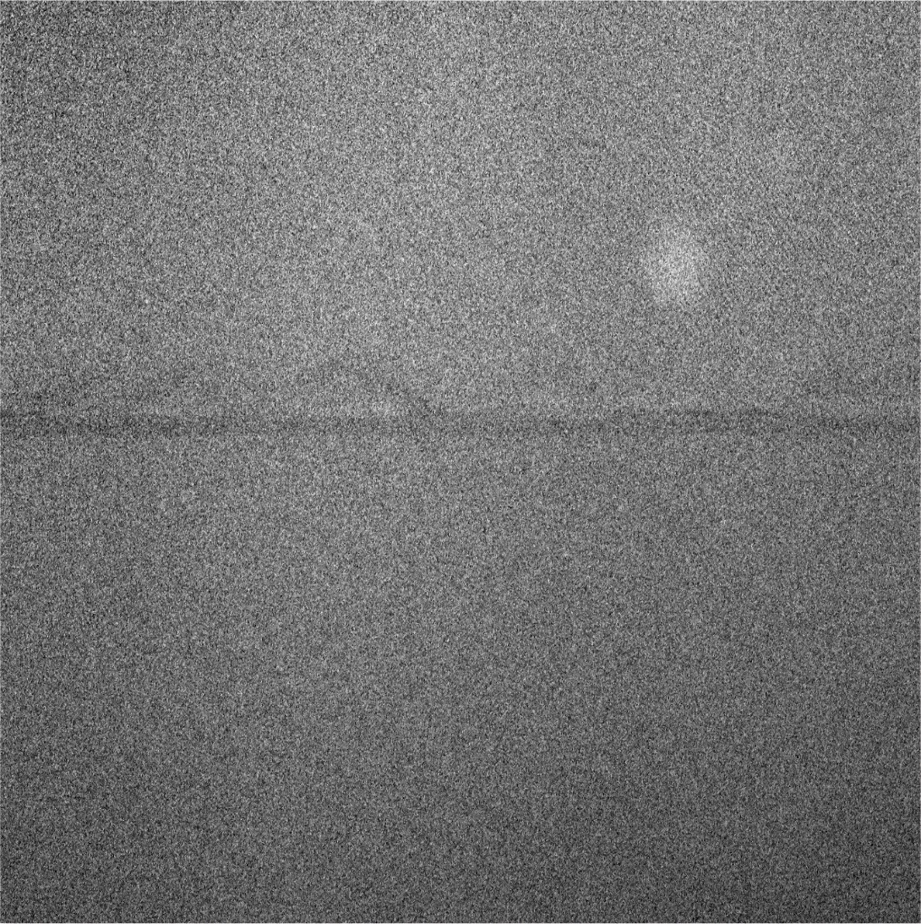
HAADF STEM image of N containing sample
0.1 µm p+ InAs X10¹⁸
0.3µm p+ InAs X10¹⁷
20 nm InAs
10nm InAlAs
10nm InNAs
10nm InAlAs
20 nm InAs
0.1µm n+ InAs X10¹⁷
0.3µm n+ InAs X10¹⁸
InAs: n-type
InAs
InAlAs
InAs
Growth direction
200 nm

Slide 14
HAADF STEM image of N containing sample
0.1 µm p+ InAs X10¹⁸
0.3µm p+ InAs X10¹⁷
20 nm InAs
10nm InAlAs
10nm InNAs
10nm InAlAs
20 nm InAs
0.1µm n+ InAs X10¹⁷
0.3µm n+ InAs X10¹⁸
InAs: n-type
InAs
InAlAs
InAs
Growth direction
200 nm

Slide 15
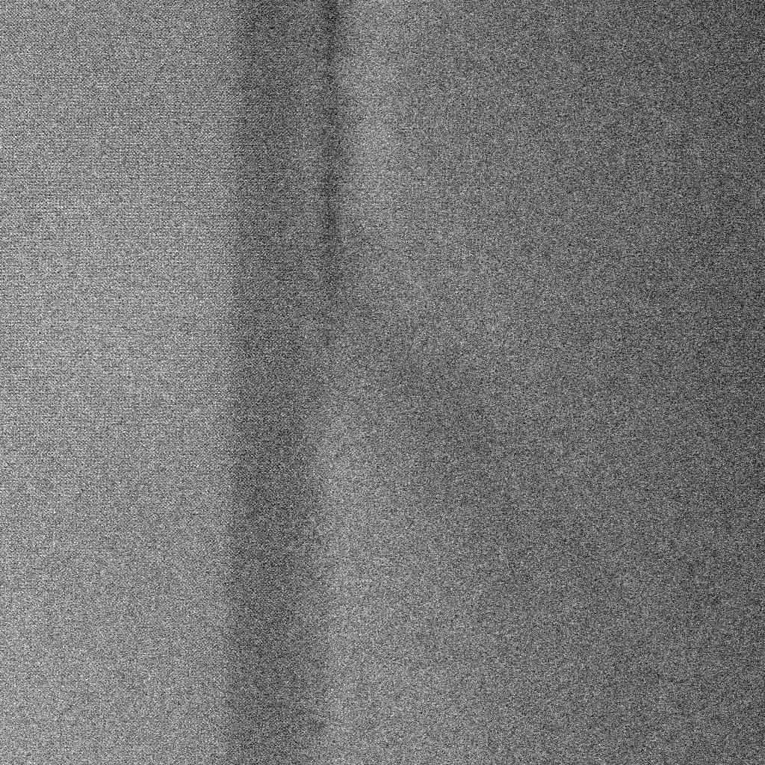
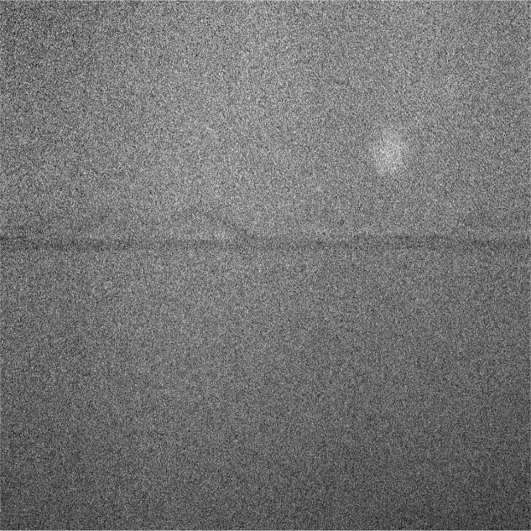
HAADF STEM image of N containing sample
InAs
InNAs ?
Growth direction
InAlAs
Growth direction
200 nm
InAs
20 nm

Slide 16
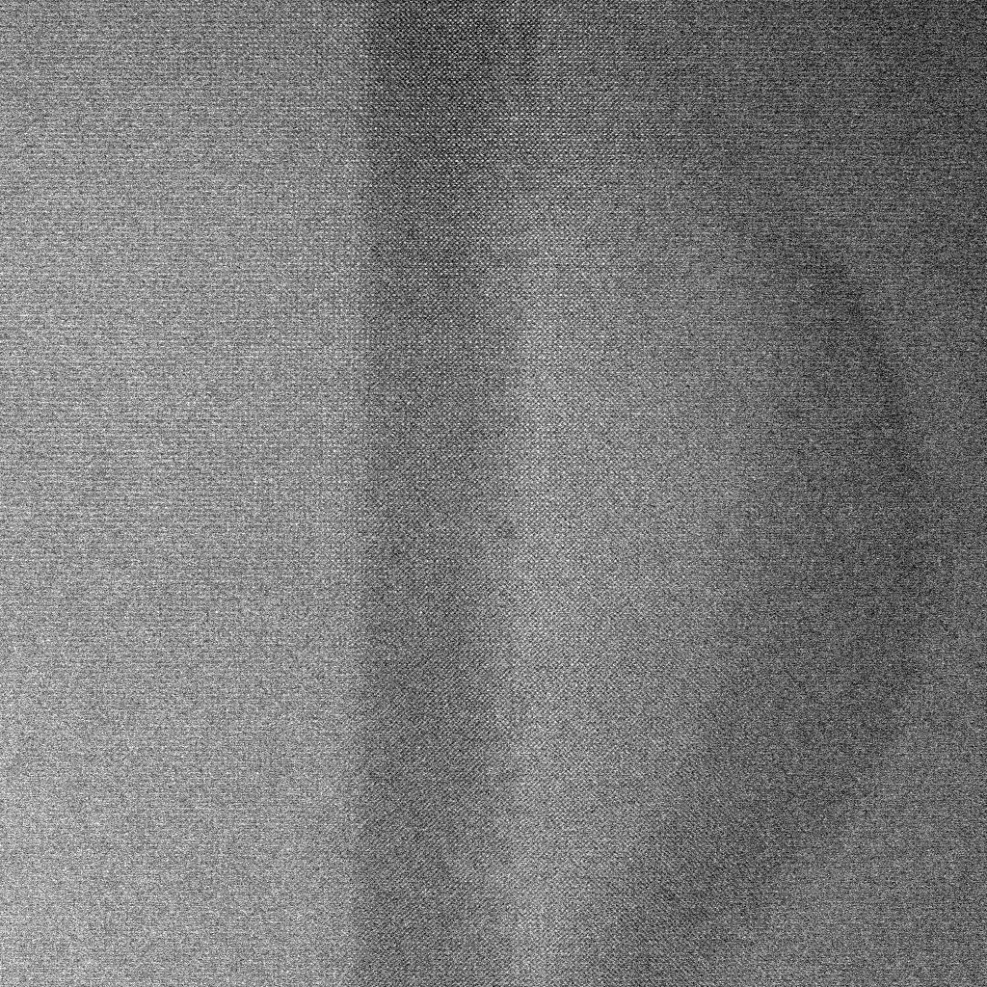
HAADF STEM image of main sample
InAs
InAlAs
Growth direction
Growth direction
200 nm
InAs
20 nm

Slide 17
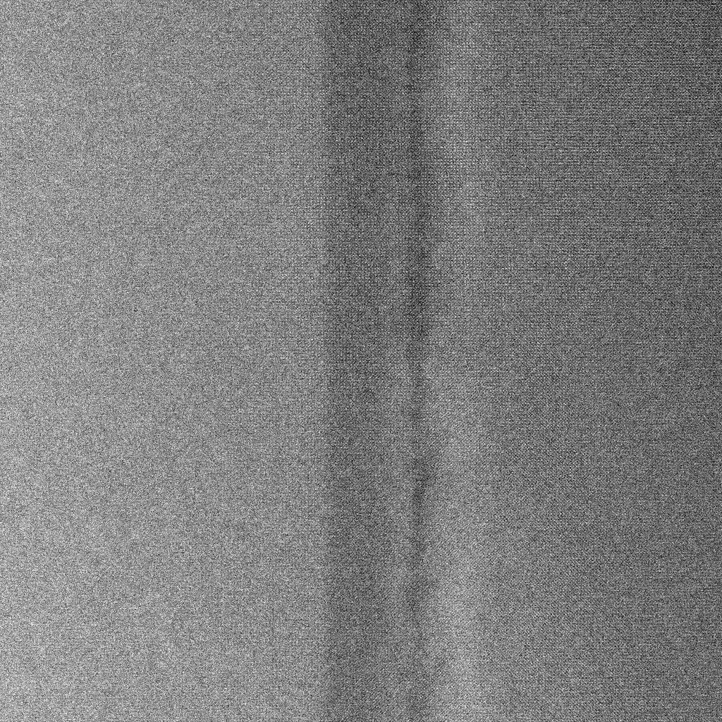
HAADF STEM image of N containing sample
InAs
InNAs ?
InAlAs
Growth direction
Growth direction
200 nm
InAs
20 nm

Slide 18
HAADF STEM image of main sample
InAs
InAlAs
Growth direction
Growth direction
200 nm
InAs
20 nm

Slide 19
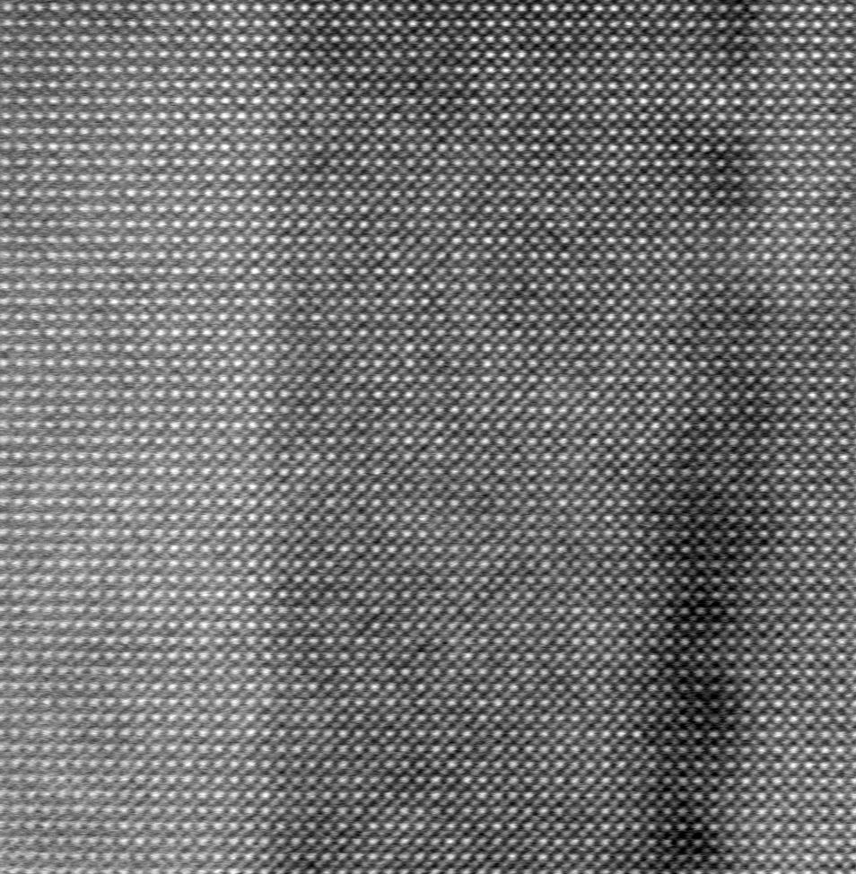

HAADF STEM image of N containing sample
Growth direction
20 nm
5 nm

Slide 20
Summary
STEM is a useful techniques to observe materials at atomic level and STEM images can be directly interpreted based on intensity.
Reference sample (no N in the QW) looks quite good i.e. seems to be grown as expected.
Many structural changes have been observed in the N containing sample.
Electron Microscopy is a useful technique to observe materials at atomic level and STEM images can be directly interpreted based on intensity.
observe materials at atomic level and STEM images can be directly interpreted based on intensity.

Slide 21
Summary
STEM is a useful techniques to observe materials at atomic level and STEM images can be directly interpreted based on intensity.
Reference sample (no N in the QW) looks quite good i.e. seems to be grown as expected.
Many structural changes have been observed in the N containing sample.
Electron Microscopy is a useful technique to observe materials at atomic level and STEM images can be directly interpreted based on intensity.
observe materials at atomic level and STEM images can be directly interpreted based on intensity.
Future
.
Energy Dispersive X-ray Spectroscopy on N containing sample.
STEM investigation of InNAsSb/InAs sample.
Secondment to Lancaster University.

Slide 22



Thank you for your attention!

Slide 23

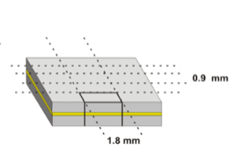
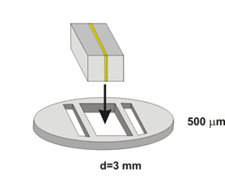
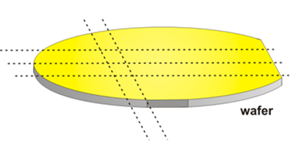

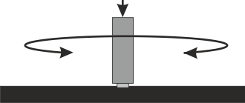
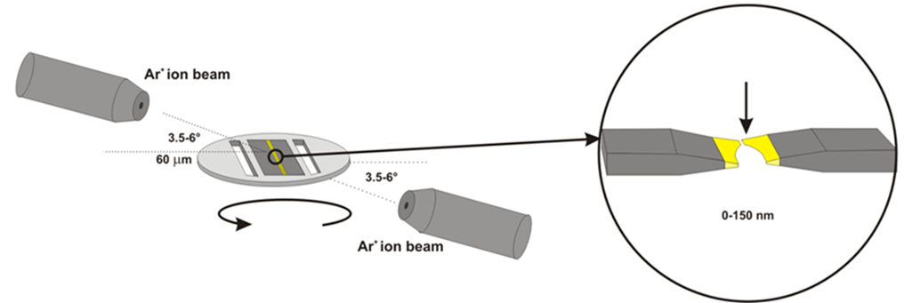
Cross section sample preparation
1. cleave the wafer
2. glue two parts together
3. create a block with a
thickness of 0.9 mm and
a width of 1.8 mm using
a diamond saw and glue
it into a titan pan
4. grind down the sample to
a thickness of around
100µm and polish it from
both sides.
5. create a small hole by
using the Precision Ion
Polishing System (PIPS)
2
3
1
1.8 mm
Wafer
0.9 mm
500µm
0.9 mm
d = 3mm
0.9 mm
4
Pressure
5
wedge shaped sample

Slide 24
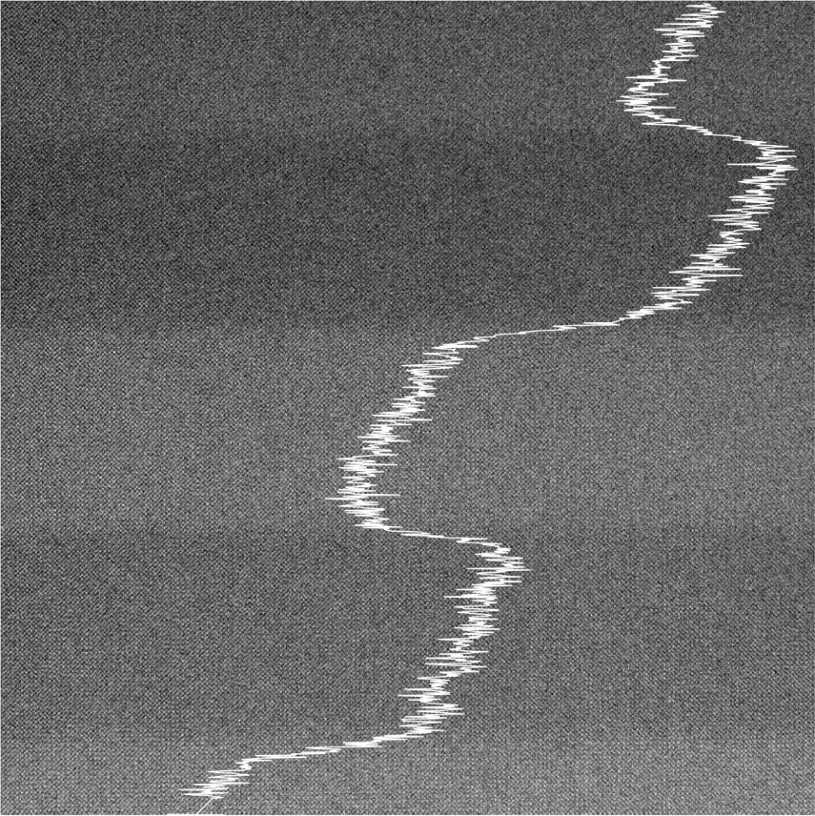
Quantitative Evaluation of images
Correction of the thickness gradient in the acquired data
intensity decreases
5 nm
5 nm
5 nm
QW
thickness
increases
5 nm
5 nm

Slide 25

Thickness gradient corrected image
intensity decreases
20 nm

Slide 26
